Slide 1

Financial Data Analysis
Presented By:
P . Sandeep Yadav
Batch : 514

Slide 2
About me:
I am a graduate in B. Tech (Artificial Intelligence & Data Science) from
guru nanak institutions. As a training I joined in innomatics to up-skilling myself in data-science
Why you want to learn Data Science:
I am interested in analyzing data and solving real-world problems and to build my career in Data Science and modern technologies
GitHub: https://github.com/sandeeppanga07
LinkedIn : https://www.linkedin.com/in/sandeep-panga-54427a3bb/

Slide 3
Agenda
Business Problem
Problem Statement
Objectives
Tables & Columns
Data Modelling
Dashboards
Key Insights
Conclusion
Recommendations
Q & A

Slide 4
Business Problem
Financial Performance Analysis of Public Companies
Organizations, investors, and financial analysts need to evaluate the financial
health and performance of companies over time. However, financial
information is spread across multiple statements such as the Income Statement,
Balance Sheet, and Cash Flow Statement, making it difficult to compare companies
and identify trends efficiently.
Manual analysis of these large financial datasets is time-consuming and may not reveal
important insights such as revenue growth, profitability, liquidity, debt levels, and cash
flow performance.
Therefore, there is a need for an interactive Business Intelligence solution that
integrates financial data, transforms it into a structured model, and provides visual
dashboards for informed decision-making.

Slide 5
Problem Statement
The objective of this project is to analyze financial statement data of multiple companies and develop an interactive Power BI dashboard that enables users to:
Monitor company financial performance over time.
Compare revenue, profitability, assets, liabilities, and cash flow across companies.
Identify top-performing and underperforming companies.
Analyze year-over-year financial growth and trends.
Support investment and business decisions using visual analytics.

Slide 6
Objective
Analyze annual and quarterly financial statements.
Compare financial performance across multiple companies.
Measure profitability using Revenue, Gross Profit, Operating Income, and Net Income.
Evaluate financial position using Assets, Liabilities, and Shareholder Equity.
Assess cash flow performance and liquidity.
Track financial trends over multiple reporting periods.
Develop interactive dashboards for business users and investors.

Slide 7
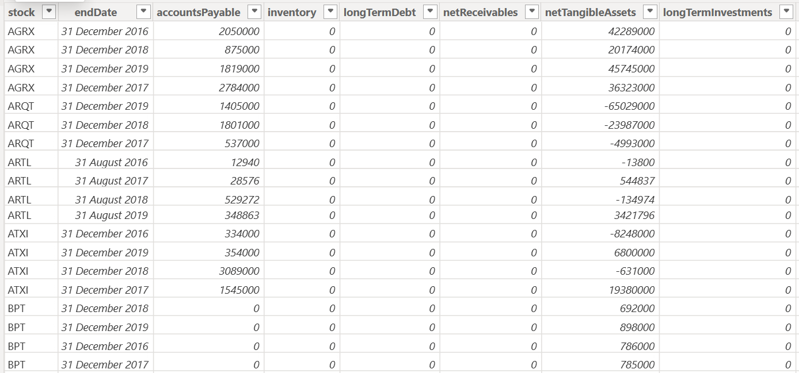
Table Overview

Slide 8
Column Description
Stock: Company stock symbol
End Date: Reporting period end date.
Investments: Cash used for investments.
Free Cash Flow: Cash remaining after operating expenses and capital expenditures (if available in your dataset).
Inventory: Value of goods available for sale
Goodwill: Intangible asset representing brand value or acquisitions
Long Term Debt: Debt payable after one year.

Slide 9
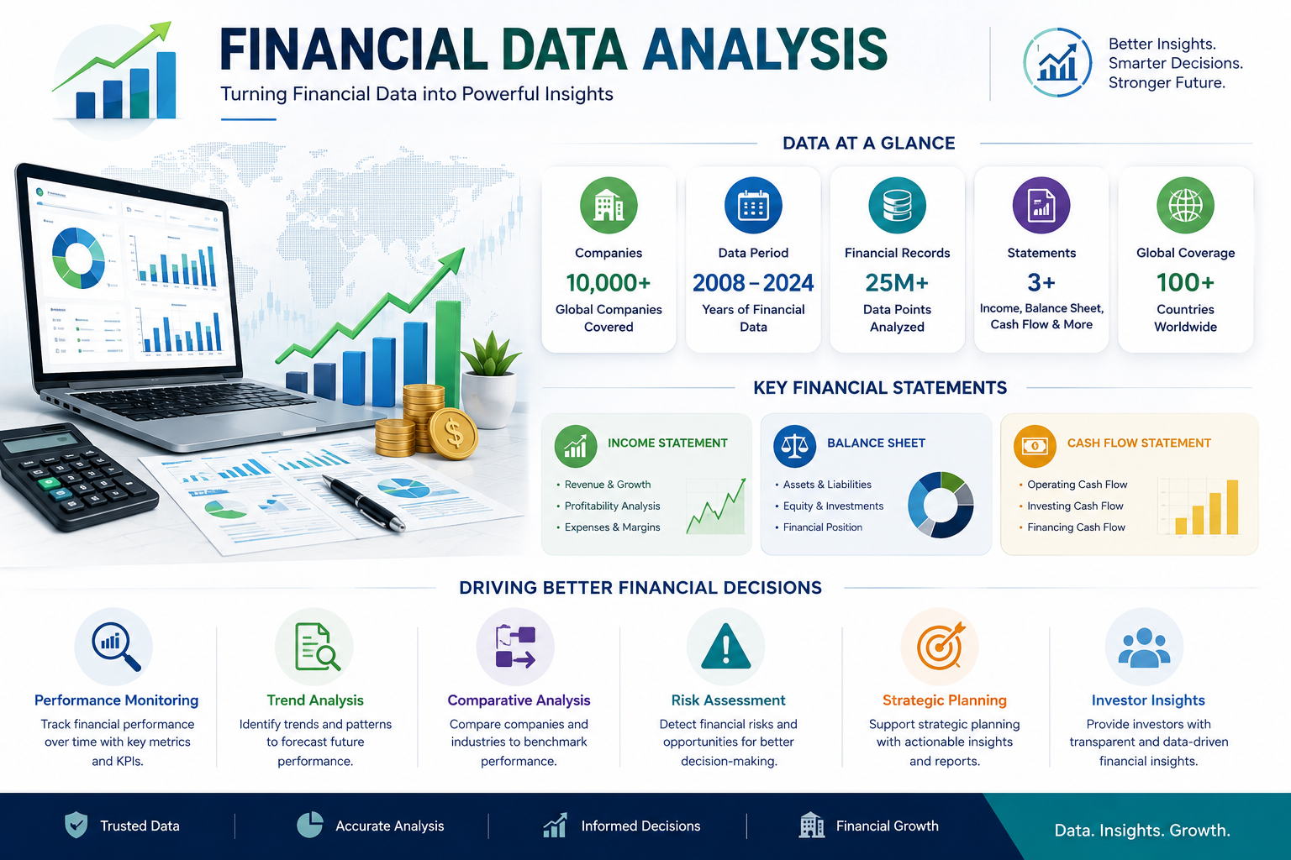

Slide 10
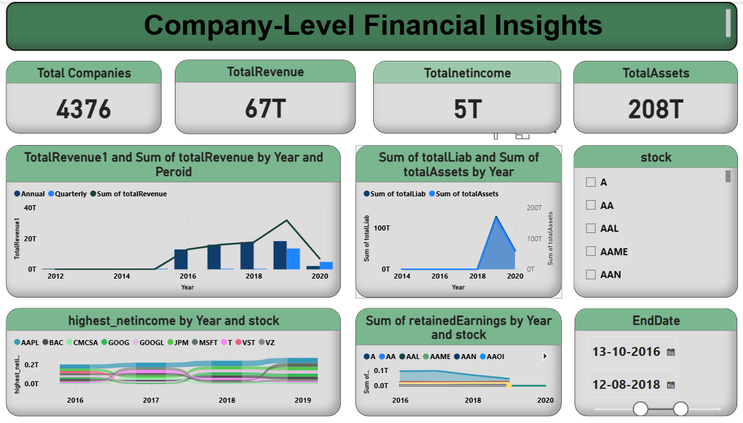

Slide 11
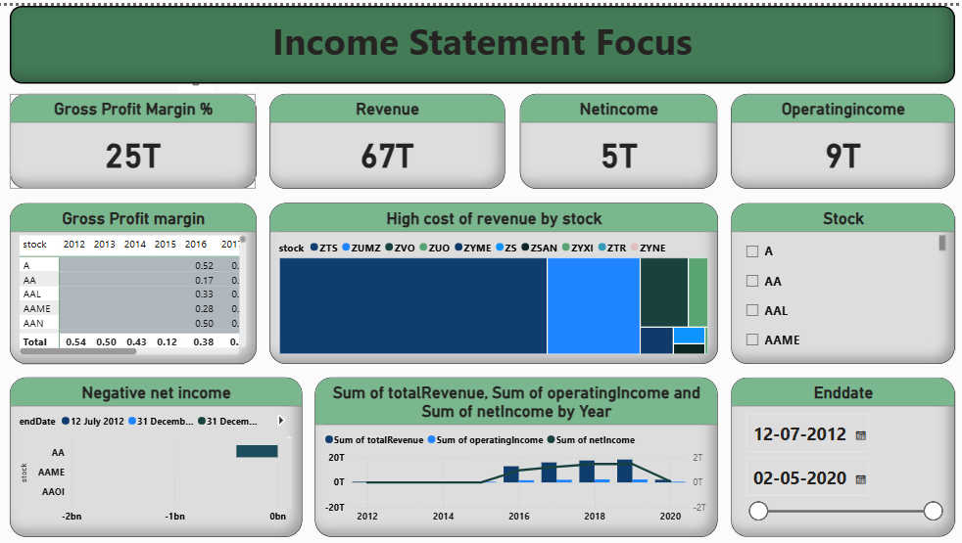

Slide 12
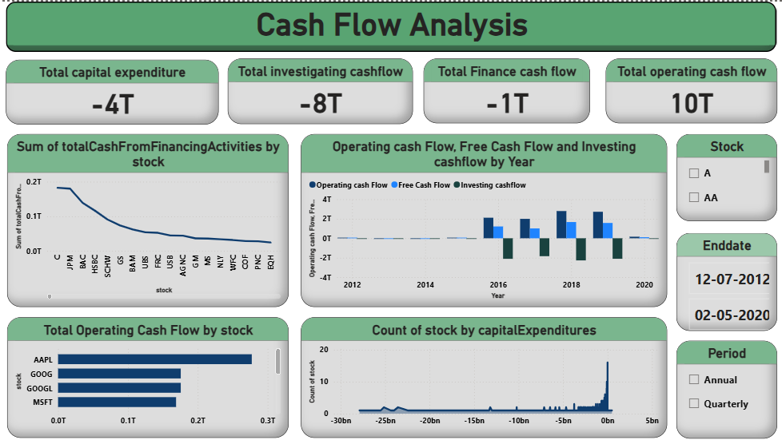

Slide 13
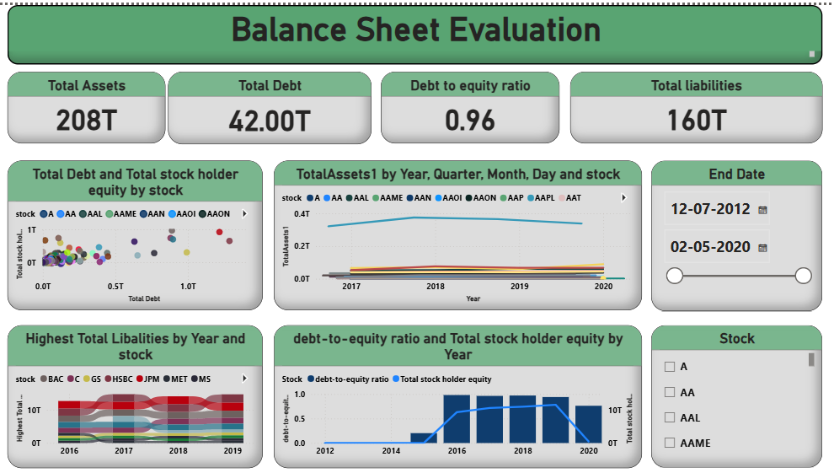

Slide 14
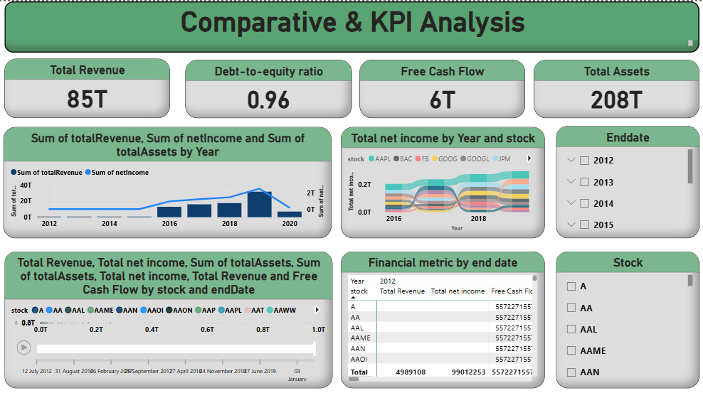

Slide 15
Key Insights
Revenue Performance
Compare annual and quarterly revenue across companies.
Profitability Analysis
Identify companies with the highest net income.
Financial Position
Compare total assets, liabilities, and shareholder equit
Cash Flow Performance
Compare operating, investing, and financing cash flows.
Comparative Financial Analysis
Compare revenue, net income, assets, and cash flow across companies.

Slide 16
Conclusion
The Financial Data Analysis Dashboard developed using Power BI successfully
transforms raw financial statement data into meaningful business insights.
By integrating the Company, Income Statement, Balance Sheet, and Cash Flow
Statement datasets, the dashboard provides a comprehensive view of the
financial performance of multiple companies..

Slide 17
Recommendations
Improve data quality by regularly validating and cleaning financial data before analysis.
Use a centralized data model with proper relationships (Star Schema) to improve dashboard accuracy and performance.
Integrate real-time financial data from trusted APIs (e.g., Yahoo Finance, Alpha Vantage) for up-to-date analysis.
Include additional financial ratios such as Return on Equity (ROE), Return on Assets (ROA), Current Ratio, and Quick Ratio for deeper insights.
Implement forecasting techniques to predict future revenue, profitability, and cash flow trends.
Add industry and sector comparisons to benchmark company performance against competitors.

Slide 18


Slide 19

THANK YOU

